Slide 1
Midterm Revision
ENGL 108 MED B - Amal Alhadidi

Slide 2
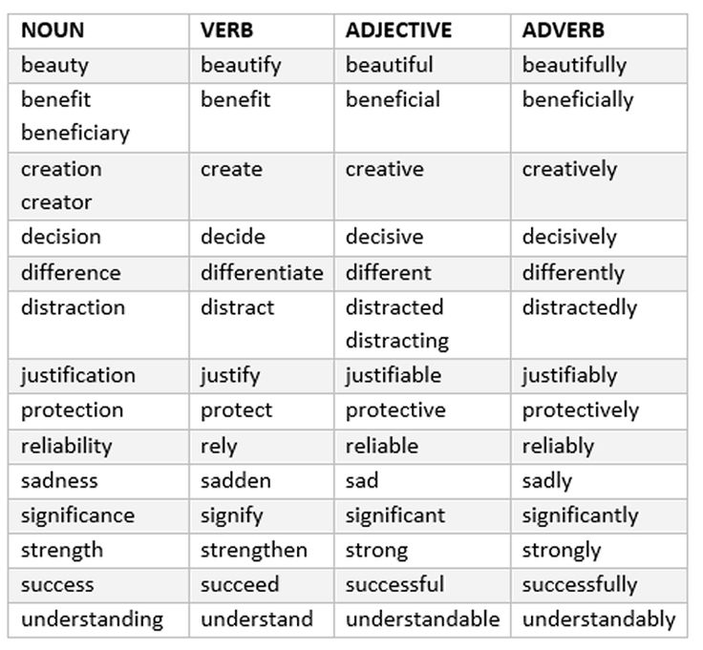
Word forms: nouns and verbs

Slide 3
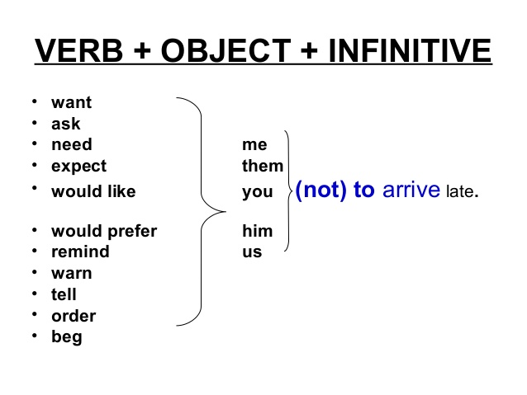
verbs + infinitives (like, want and need)

Slide 4
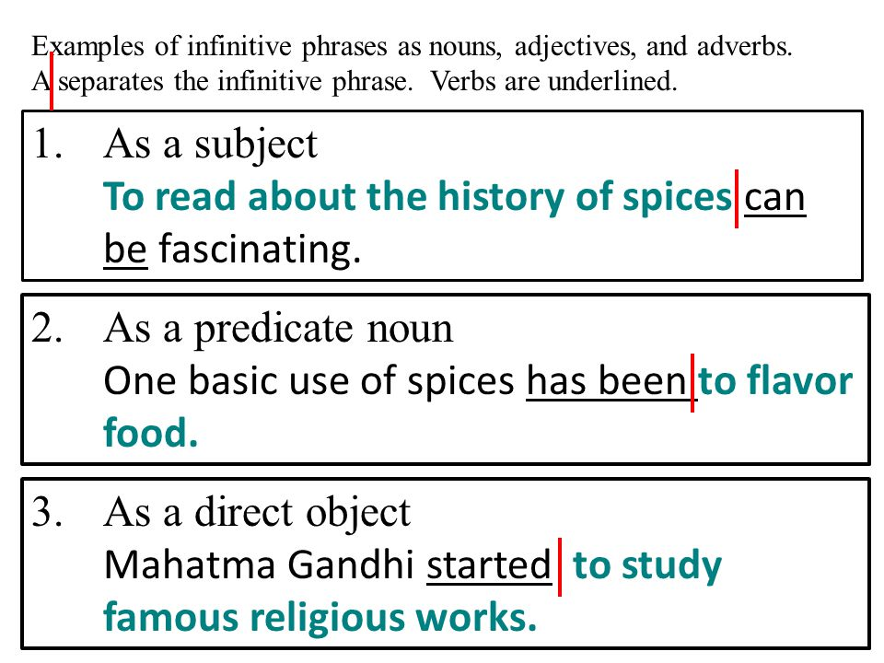
noun phrases and infinitives

Slide 5
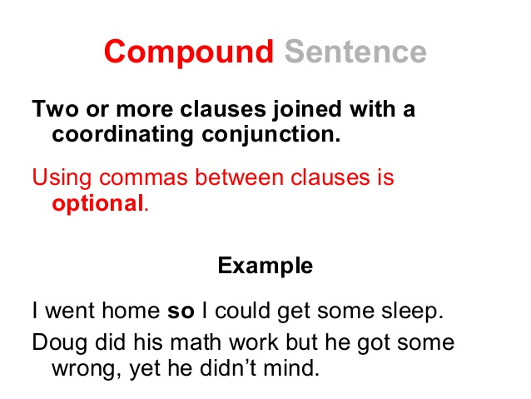
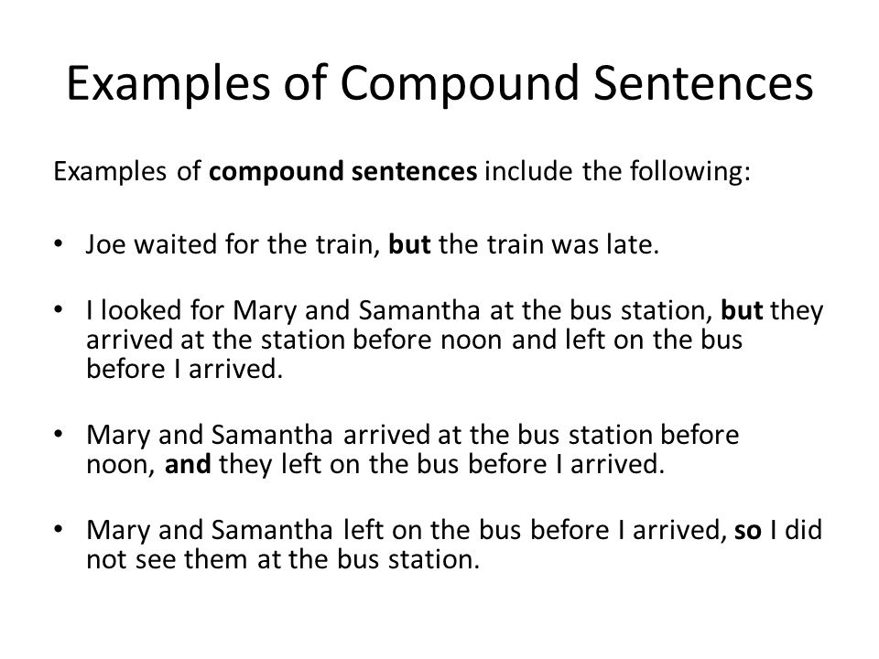
Writing compound sentences with but and so

Slide 6
Word roots: lone, fac, migra, nat, pop
-bio- (G) Migra Pop Fac Nat alone | Life This ROOT-WORD is MIGRA which comes from the Latin migrare & meaning TO LEAVE ONE PLACE AND WANDER TO ANOTHER. This ROOT-WORD is POP which comes from populi Latin for PEOPLE. These ROOT-WORDS are FAC & FACT meaning MAKE These ROOT-WORDS are NASC & NAT meaning TO BE BORN & TO SPRING FORTH | biography, biology, biodegradable, symbiotic Migrant , Immigratory , Migrate , Migration , Migratory, Migrative, Migratorial Populace, Popular, Popularity, Popularism, Popularist Fact, factor, faction, factory, faculty, factive.. Native, nature, natural, Naturalization, nation, national…

Slide 7
verbs
Verb | 3rd person singular present tense | 3rd person singular past tense | past participle | present participle
laugh | he/she laughs | he/she laughed | laughed | laughing
love | he/she loves | he/she loved | loved | loving
boo | he/she boos | he/she booed | booed | booing

Slide 8
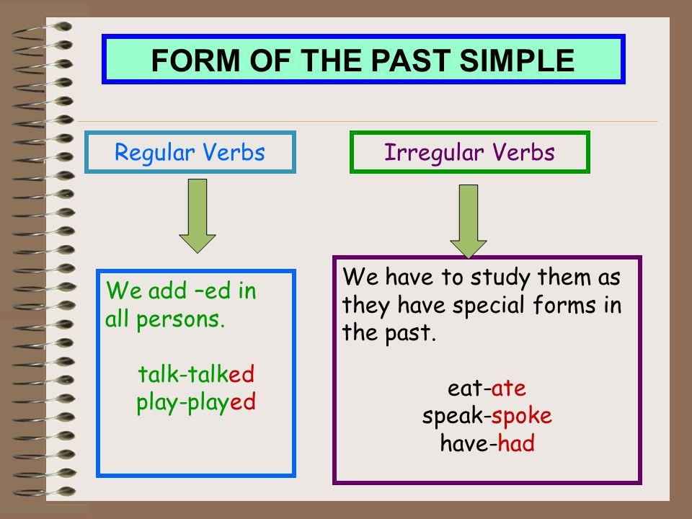
Simple past with regular and irregular verbs

Slide 9
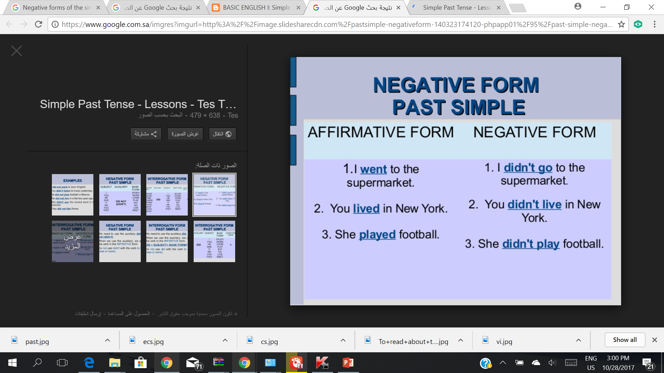
Negative forms of the simple past

Slide 10
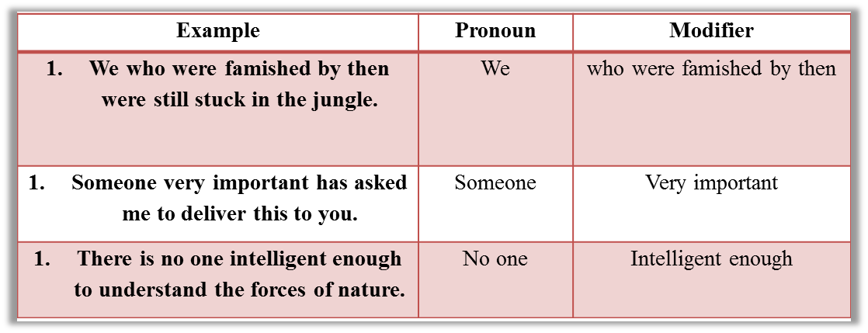
Modifying nouns

Slide 11
Sentences with because
They arrived late because of the storm.
We couldn't go out because of the rain.
I am hungry because I did not eat lunch.
I didn't tell you because I didn't know.

Slide 12
Parts of speech: noun, verb, adjective, adverb
NOUN
Example sentences: Steve lives in Sydney. Mary uses pen and paper to write letters.
ADJECTIVE
(Describe the noun)
Example sentences: The little girl had a pink hat.
VERB
(Action Word)
Example sentences: I like Woodward English. I study their charts and play their games.
ADVERB
(Describes a verb)
Example sentences: I am usually busy. Yesterday, I ate my lunch quickly.

Slide 13
Sentences with when
- It was past one o'clock when Pierre left his friend.
I ceased making the sound "wah-wah" only when I learned to spell the word.
When it finally started down the runway, she closed her eyes.
When they finally got on the plane, she and Jonathan had a window seat.

Slide 14
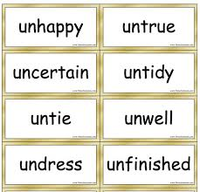
The prefix un-

Slide 15
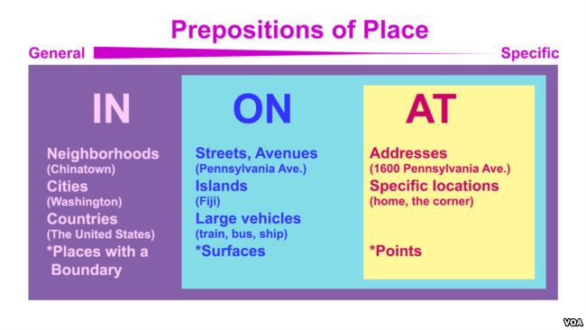
Prepositions of location: in, an, on

Slide 16
Simple present statements with regular verbs (affirmative & negative forms)
affirmative negative
I/you/we/they I play. I do not play.
he/she/it He plays. He does not play.

Slide 17
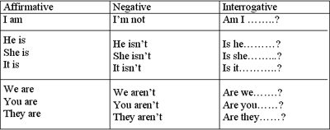
Simple present statements with be (affirmative & negative forms)
am
be = is
are

Slide 18
Simple present statements with have (affirmative & negative forms)
The verb "have" is irregular in positive, third-person forms. This irregular form has been marked below with an asterisk*
Positive | Negative
I have. | I do not have.
You have. | You do not have.
We have. | We do not have.
They have. | They do not have.
He has. * | He does not have.
She has. * | She does not have.
It has. * | It does not have.

Slide 19
Simple past with regular and irregular verbs
Regular verbs: Verb + ed → Yesterday, he played football.
Irregular verbs:
be | was/were
write | wrote
come | came
do | did
meet | met
speak | spoke

Slide 20
Simple past in negative statements
I, you, he, she, it, we, they | did not/didn't | play
 |  | write
 |  | do
I didn't like the food in the wedding last Saturday.
I didn't eat it.

Slide 21
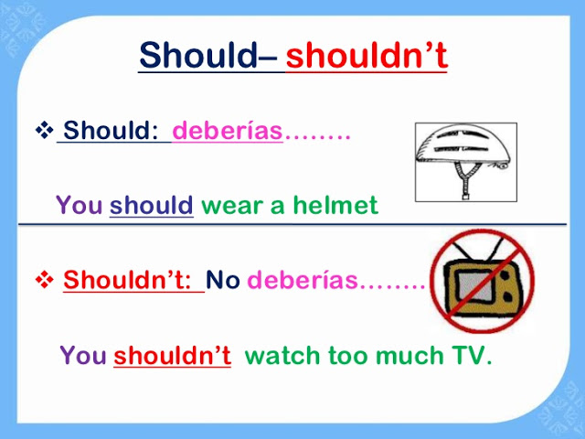
should and shouldn’t

Slide 22
It's + adjective + infinitive
It is nice to buy another pair
It is important to lock the door
It is necessary to call your parent
* It is → it’s

Slide 23
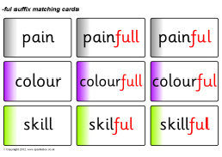
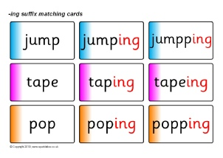
Suffixes: -ful and -ing

Slide 24
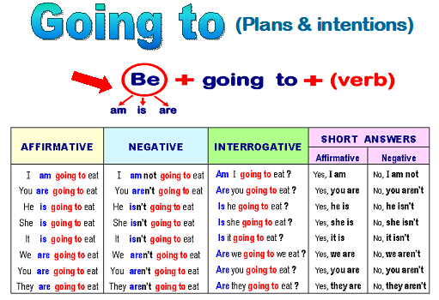
Be going to Be going to statements Be going to questions

Slide 25
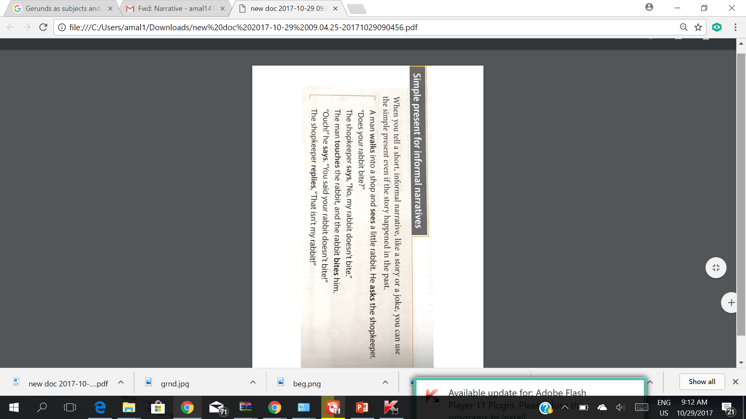
Simple present for informal narratives

Slide 26
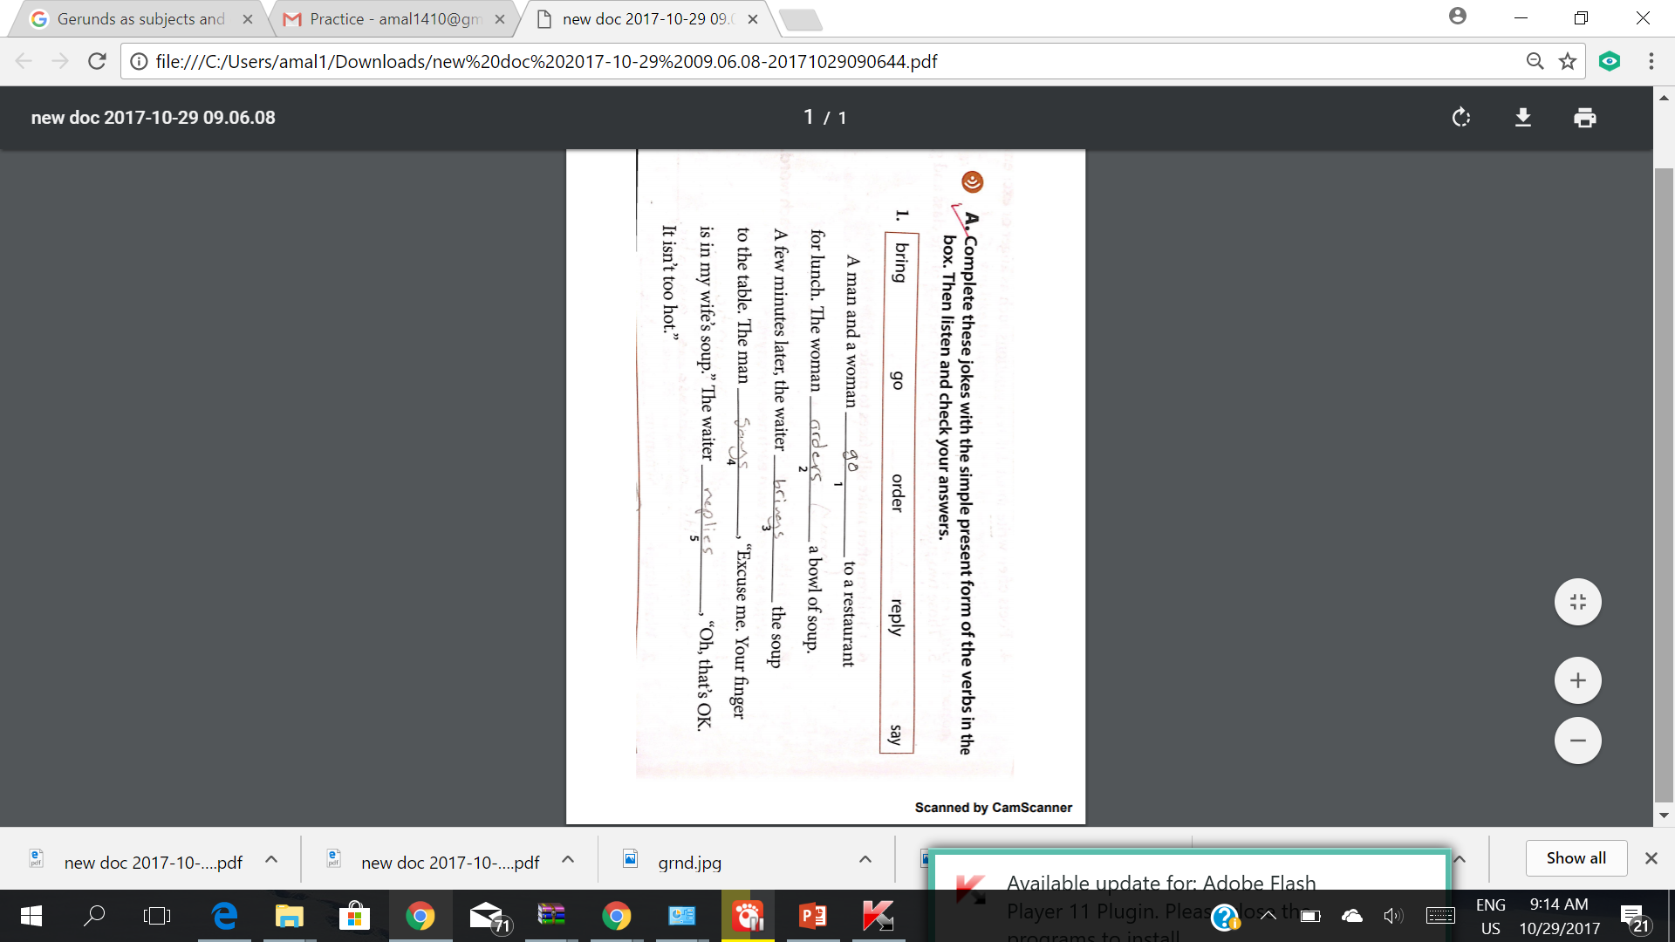
Simple present for informal narratives

Slide 27
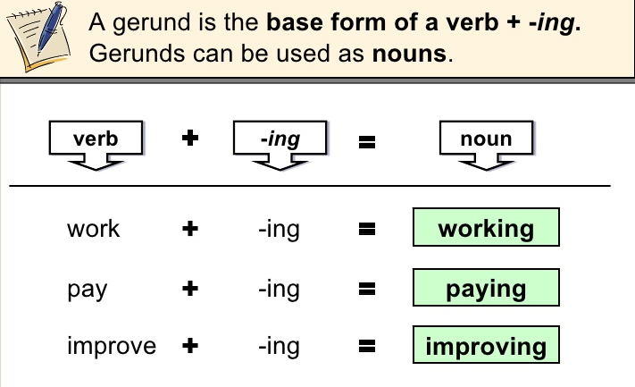
Gerunds as subjects and object
Cooking is my hobby. →
Dancing is great fun. →
I like reading →

